Slide 1
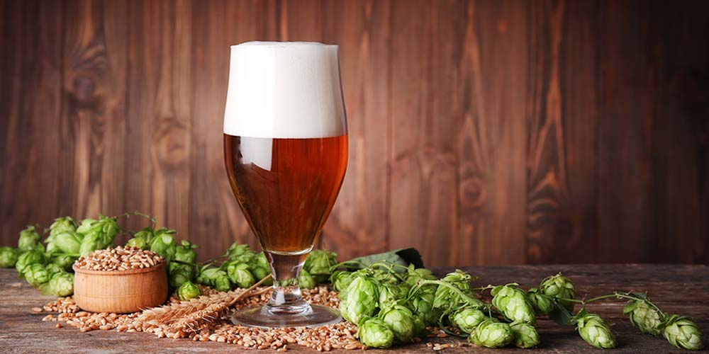
Brewing Success: Navigating the InBev and AB Merger for Enhanced Value Creation
Vishnu Kariyattu, Yash Mandhana, Dheeraj Pherwani
Shashank Ranjan, Sam Schreier

Slide 2




InBEV AND AB MERGER- WHY?
Objective
To create the world’s largest brewer with enhanced competitiveness
Markets
InBev higher presence in LATAM and Europe; AB 92% sales in North America
InBev supported AB wholesalers and the three-tier distribution system
InBev gains access to Bud line licenses globally
Product Portfolio
InBev gains access to ‘value’ group with Busch brand
AB initially an importer of InBev products. Access to InBev products with ease in supply chain
AB owned interests in several craft brewers (11% growth rate)
Financials
Increased access to capital
Cost-savings

Slide 3
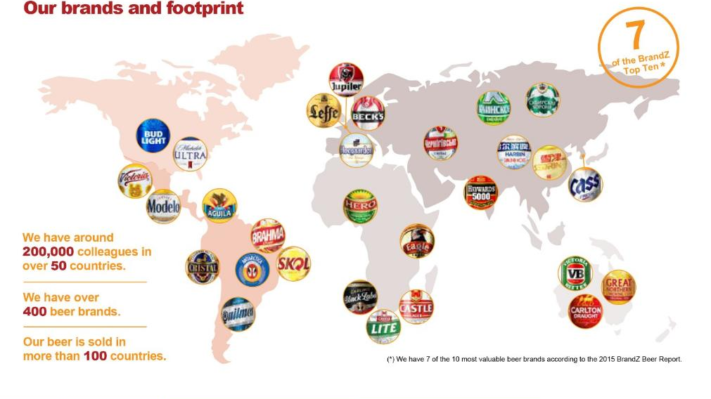
InBev and Anheuser Busch merger

Slide 4
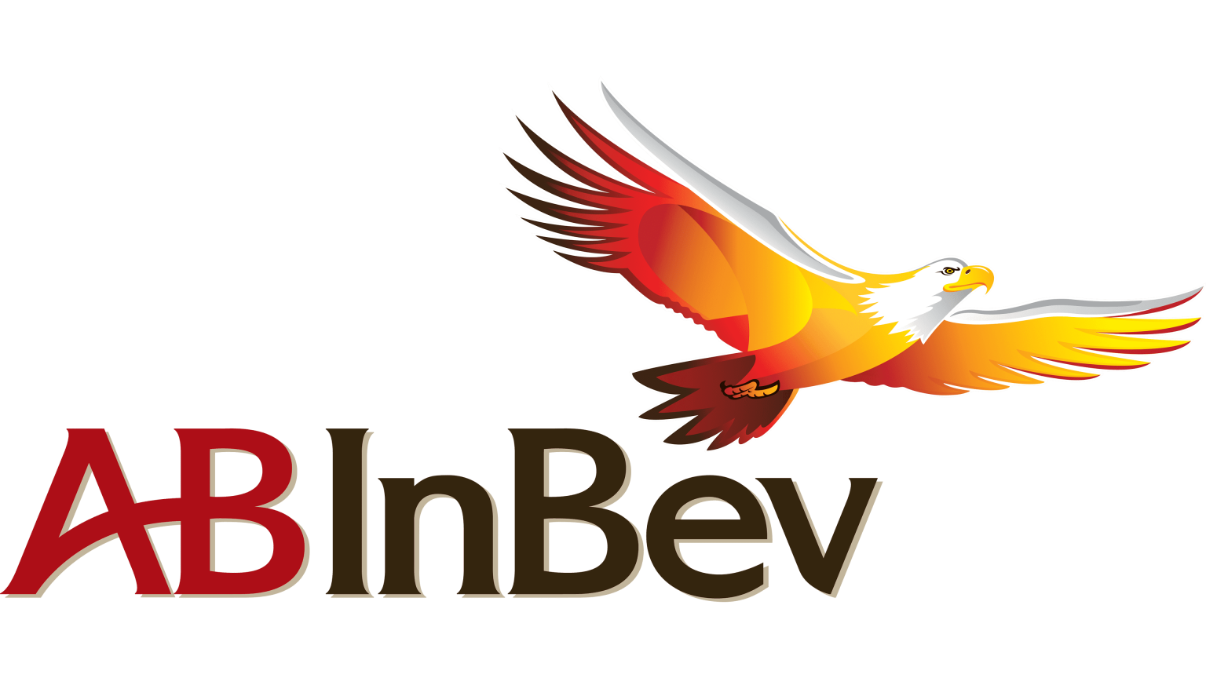
Sources of Synergy & Premium Paid Split
AB InBev is now the worlds largest beer company
Unrivaled economies of scale
Distribution network
Increased cost savings
A global brand portfolio

Slide 5

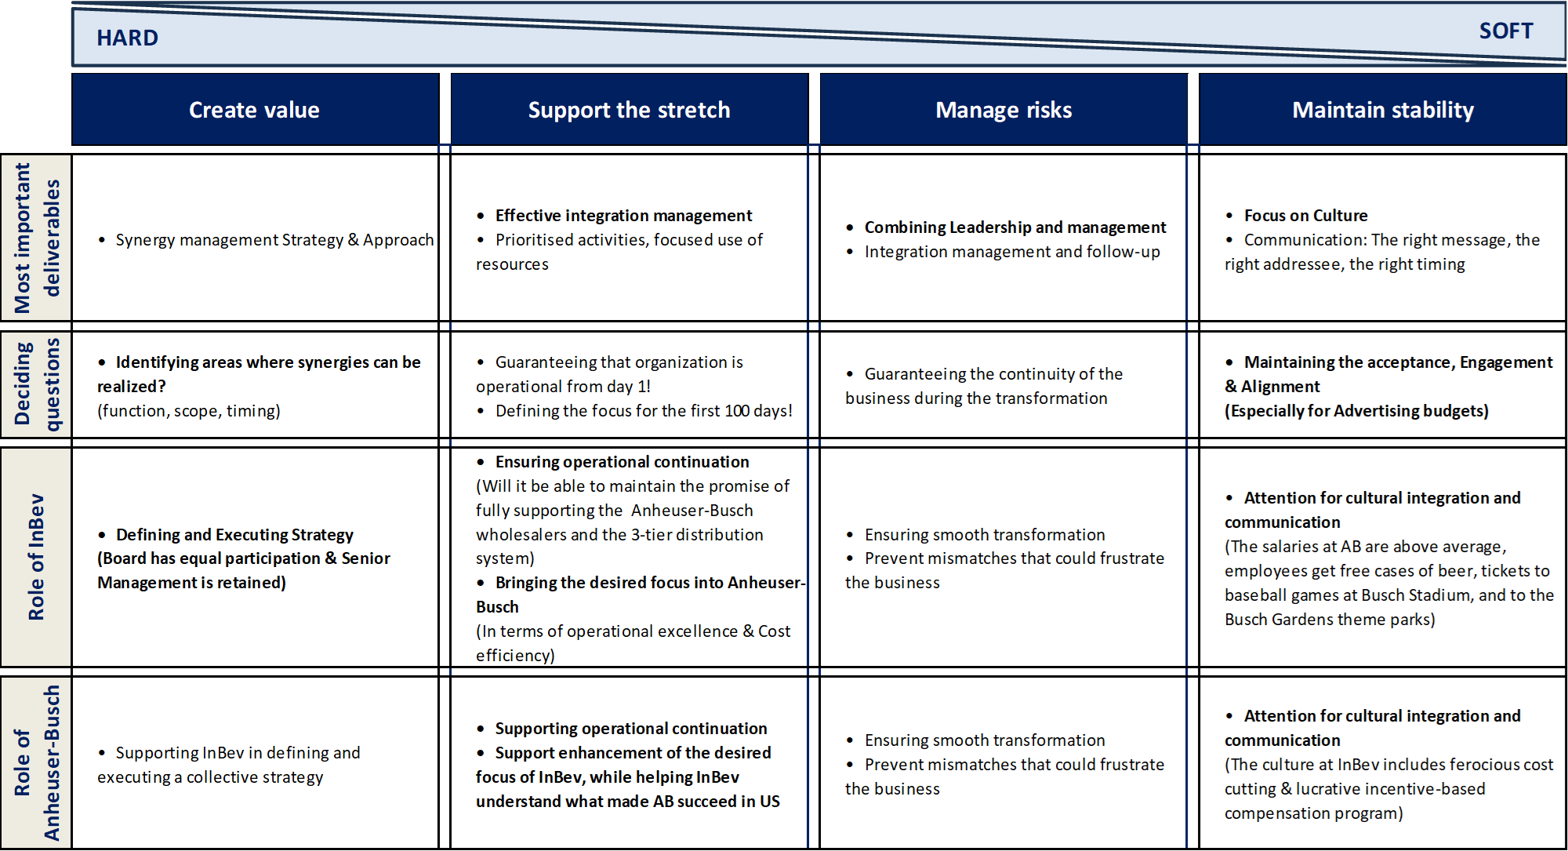
Post-Merger Integration (PMI) Challenges

Slide 6





Overcoming PMI Challenges
Challenge | Solution | Support | From the Article
Cultural Integration | Implement comprehensive cultural integration programs. | Merging distinct cultures of InBev (lean, cost-cutting, meritocratic) and Anheuser-Busch (luxurious, perks, philanthropy). | - InBev CEO Carlos Brito advocates for performance-based incentives.
Communication | Establish clear communication channels and platforms for sharing information. | Bridge communication gaps between diverse teams and regions. | - Anheuser-Busch has a significant marketing budget ($500 million annually in US). - InBev is known for innovative marketing strategies (iconic Budweiser advertising).
Employee Retention & Engagement | Implement retention strategies and enhance employee engagement initiatives. | Address concerns and maintain morale amidst cultural changes. | - Anheuser-Busch: strong employee-centric culture with perks (free beer, tickets). - InBev: lean structure with performance-based incentives.
Operational Integration | Implement robust operational integration plans and leverage synergies. | Optimize processes and identify efficiencies across both companies. | - InBev boasts a strong EBITDA margin (34.6% in 2007). - Anheuser-Busch has significant sales and operating income figures (2007).
Synergy Realization | Develop synergy realization strategies focused on cost savings and revenue enhancement. | Maximize the value created by the merger. | - InBev's offer: $70 per share (35% premium over pre-deal Anheuser-Busch price). - Total payout: $52.5 billion to shareholders, $2.4 billion for transaction costs.
Notes:
A successful cultural integration is crucial for employee morale and long-term success. InBev employs a performance-based incentive scheme, rewarding top performers with generous bonuses tied to business metrics and emphasizing a culture of meritocracy and efficiency.
Open communication is essential to ensure everyone is aligned post-merger.
Retaining talent from both companies is key to maximizing the merged entity's potential.
A well-defined integration plan can streamline operations and unlock financial benefits.
Anheuser-Busch's net sales in 2007 were $16,685.70 million.
Anheuser-Busch's operating income in 2007 was $2,894.00 million.
Achieving synergies is essential to justify the merger's cost and drive future growth.

Slide 7
How is $54.8 B Acquisition justified?
Acquire Profits
Strategy
New Joint Board with only 3 AB members
New Ways of Cost Cutting
Organization Structure
Systems & Processes
Adapt to New Culture
Governance & Culture
A Group of Successful
CEO’s
Leadership & People
Metrics
AB EBITDA 26.2%
Capabilities
5th Largest CPG Company

Slide 8

Thank you

